Slide 1
OneScore: Live Scores and Fantasy Football
20619 | Nabin Katwal
Project Progress review – CSC412– Class of 2022

Slide 2
Outline
Introduction
Problem Statement
Objective
Scope
Literature Review/Background Study
Methodology
Tools and Technology
Result
Conclusion
Reference

Slide 3
Introduction
A game in which participants serve as the owners and general managers of a football team.
Popular way of competing amongst a group or as individuals.

Slide 4
Problem Statement
Problem while checking the live scores.
Lack head to head competitions which leads into players creating groups outside of application in order to complete.

Slide 5
Objective
To build a system with efficient fantasy engine and leagues.
To build a system which fetches real time match data.

Slide 6
Scope
People who follow football on regular basis and want to get updated on latest football score.
People who have interest to get started in fantasy football and start playing competitively in a league.

Slide 7
Literature Review/Background Study
At the start of every season each individual is given 100M to create a team of 15 players which include 2 goalkeepers, 5 defenders, 5 midfielders and 3 attackers[1].
The points are based on player’s performances.
Chips like wildcard, free hit and triple captain[2].

Slide 8
Functional Requirements
Users shall be able to see live scores.
Users shall be able to create a fantasy team.
Users shall be able to manage a fantasy team.
Users shall be able to compete in league.
Users shall be able to create and edit their account.
Users shall be able to view in depth statistics of players.

Slide 9
Non Functional Requirements
The system must be responsive.
The system must be fast.
The system must work on real time.
The system must have low latency.

Slide 10
Methodology
Incremental model of SDLC.
Requirements divided into modules.
Experimenting with different rules to increase efficiency.

Slide 11
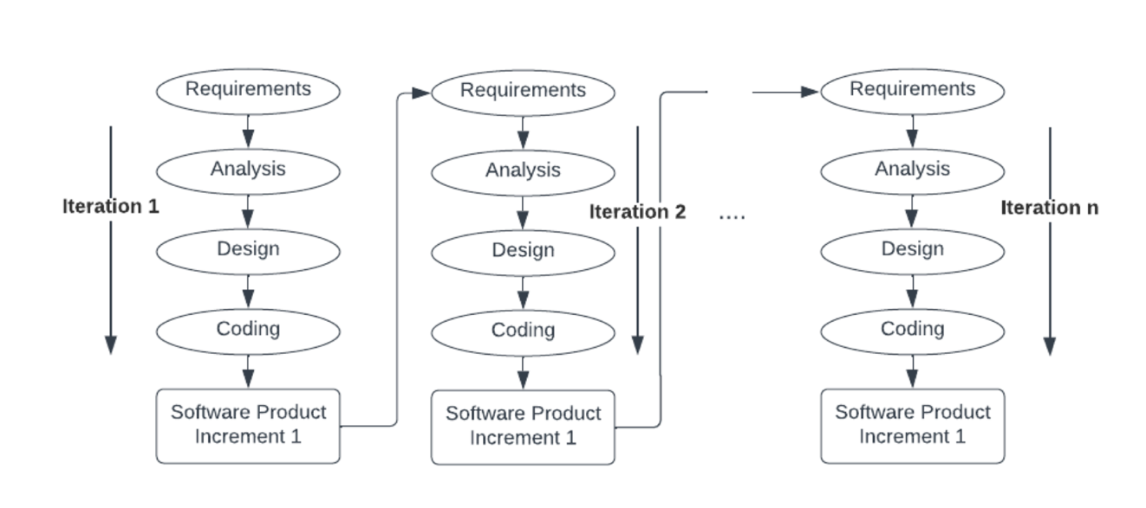
Incremental Model
Fig 1: Incremental model in SDLC

Slide 12
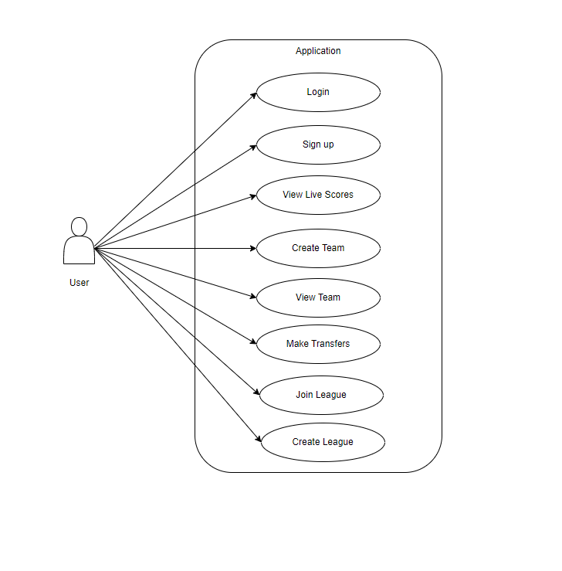
Use Case Diagram
Fig 2: Use Case Diagram of the system

Slide 13
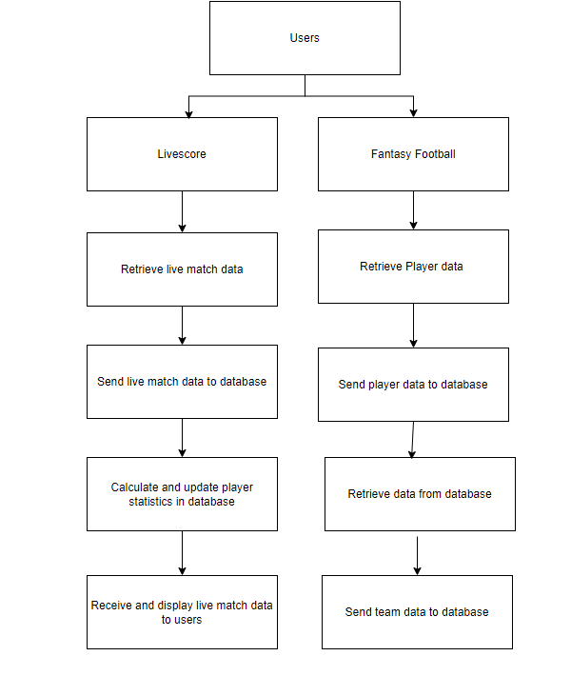
System Flow Diagram
Fig 3: System flow diagram

Slide 14
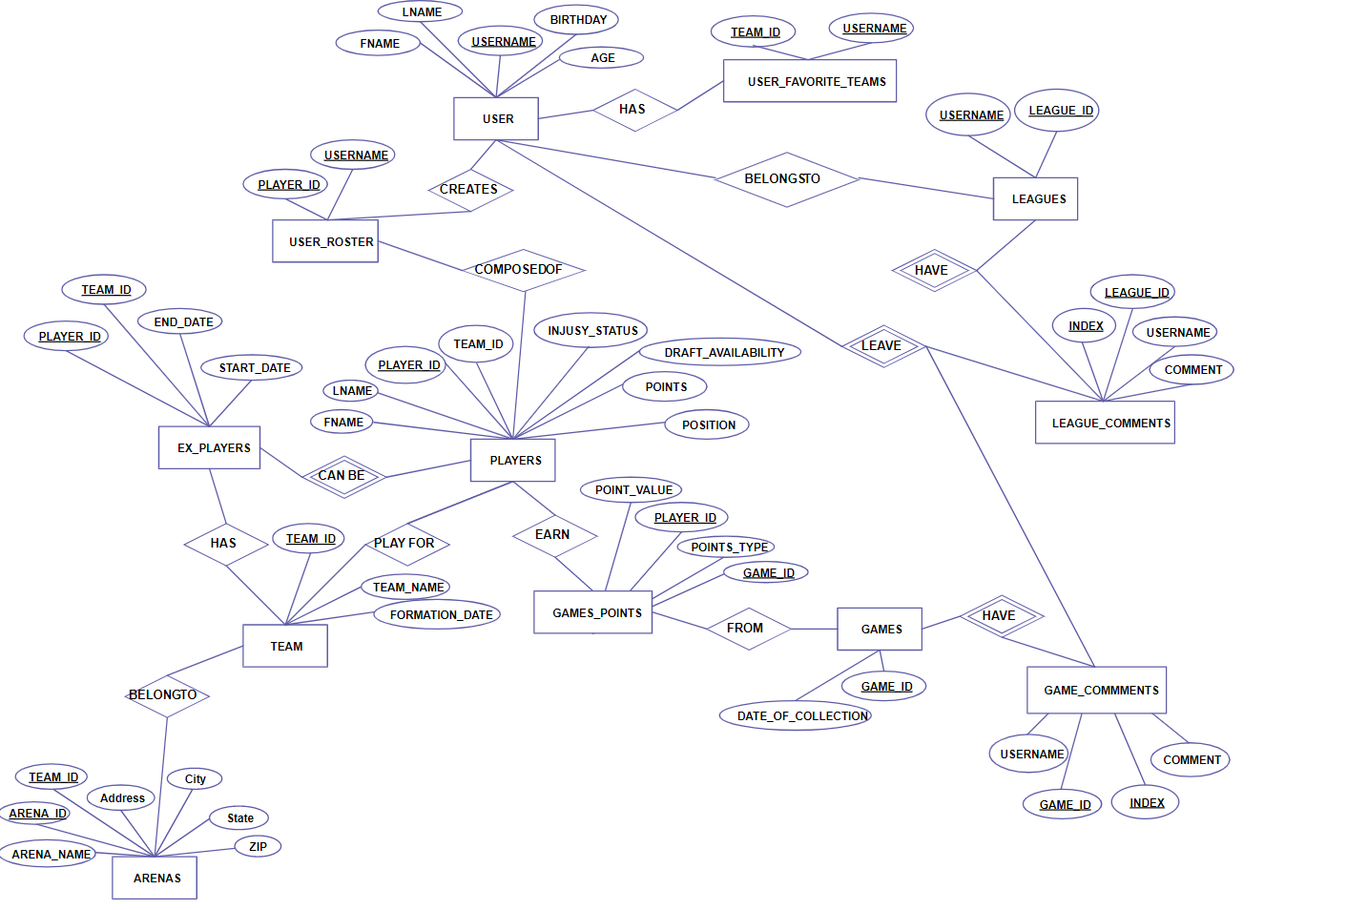
ER Diagram
Fig 4: ER Diagram

Slide 15
Tools and Technology
Front end
  Next JS
  CSS

Slide 16
Tools and Technology
Backend
  Node JS
  Express JS
  MongoDB
  Python
  Axios
  Bcrypt
  JWT

Slide 17
Progress till now
Created a database of players.
Created a frontend UI for fantasy.
Created a livescore system.
Created User system for fantasy.

Slide 18
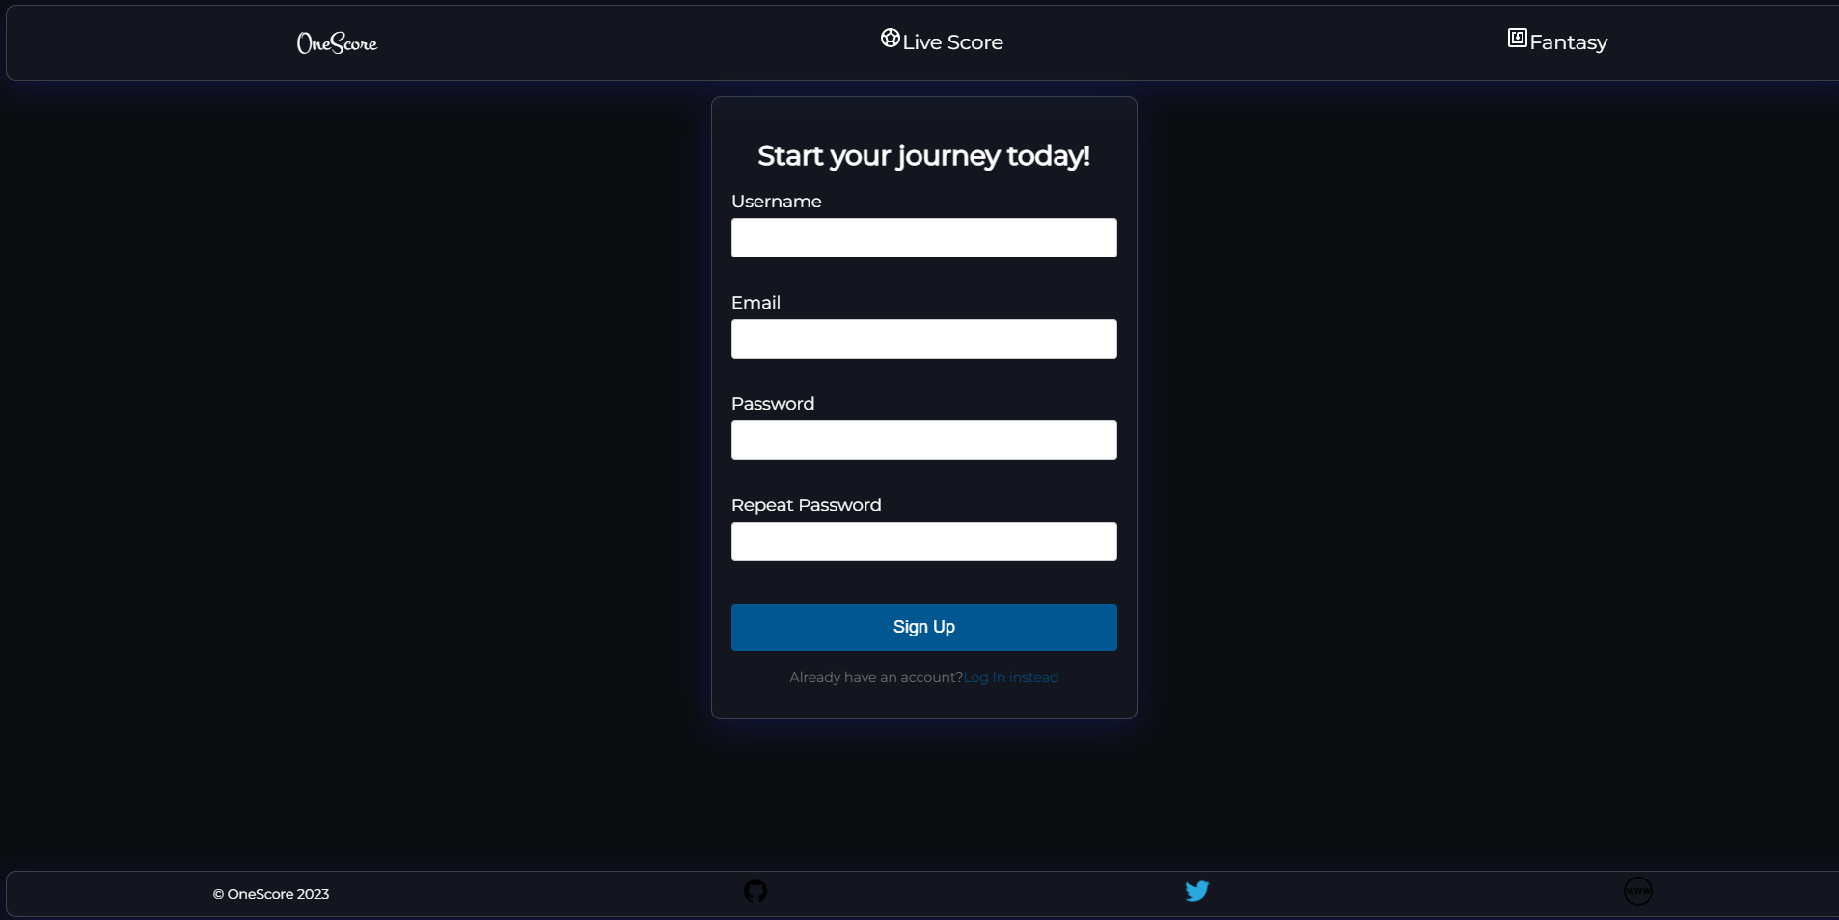
Result
Fig 5: Sign Up Page

Slide 19
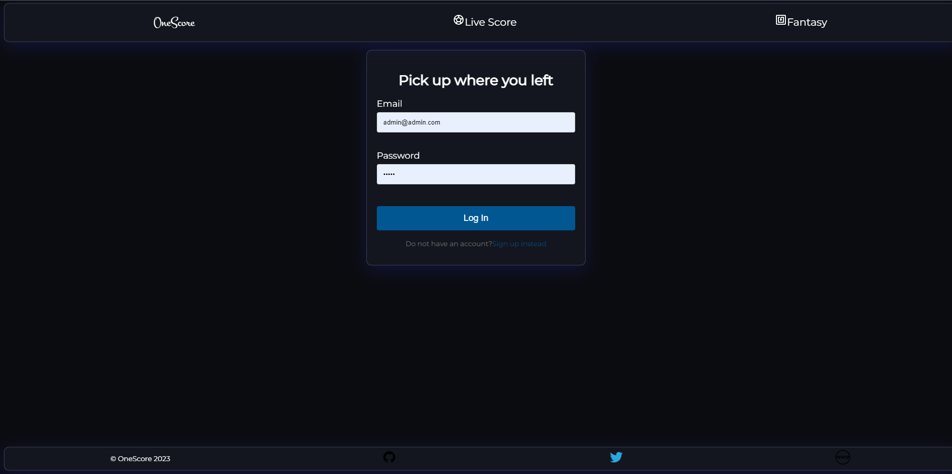
Result
Fig 6: Log In Page

Slide 20
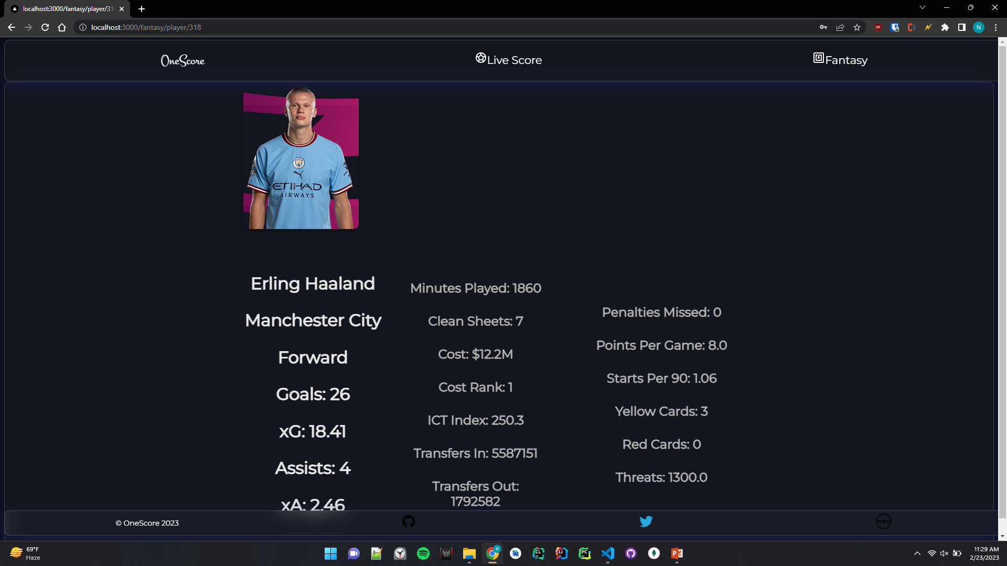
Result
Fig 7: Player Stat Page

Slide 21
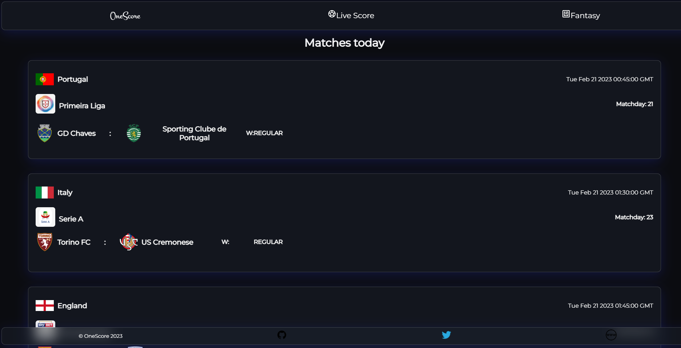
Result
Fig 8: Live Score Page

Slide 22
Conclusion
Fantasy football and live scores were implemented in Next JS.

Slide 23
Limitations
Only support for Premier League.
Livescores are only for top 5 European leagues and few other leagues.

Slide 24
References
[1] A. Gowda, "Data Analytics as a Key to Fantasy Premier League, International Journal for Research in Applied Science + Engineering," vol. 10, no. 9, p. 3, 2022.
[2] D. Whittaker, "A study of information behavior in the Fantasy Premier League Community," p. 7, 2022.

Slide 25
DEMO!!!!!

Slide 26
Thank You!!!!!

